Slide 1
A Look Inside the National Association of Estate Planners & Councils

Slide 2
Our Mission
The National Association of Estate Planners & Councils (NAEPC) promotes excellence in estate planning by serving NAEPC members, delivering exceptional resources and unsurpassed education, and recognizing those who hold the Estate Planning Law Specialist (EPLS) certification.
EXCELLENCE IN ESTATE PLANNING

Slide 3
What We Do. Simplified.
Continue the Tradition of the Founding & Primary Mission Serve and Support Affiliated Local Estate Planning Councils by Providing Benefits, Resources and Education for the Council and its Members
Recognize Qualified Multi-Disciplinary Professionals for the Benefit of the Profession & the Communities they Serve
Administration of the Accredited Estate Planner® Designation Program
Support the Efforts of the Estate Law Specialist Board, Inc.
Support Initiatives & Provide Resources to Enhance the Profession & Disciplines Within, Members, & the Country Commitment to Ongoing and Advanced Professional Education
Maintain High Ethical Standards
Resources Dedicated to Diversity, Equity and Inclusion
EXCELLENCE IN ESTATE PLANNING

Slide 4
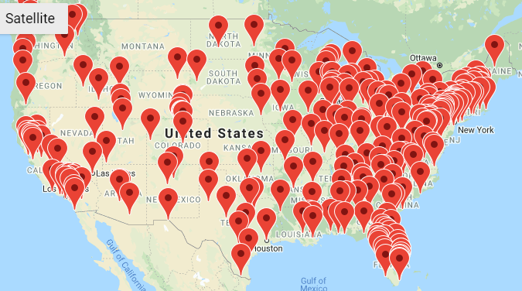
Our National Network A Snapshot of NAEPC by the Numbers
265 Affiliated Local Estate Planning Councils
28,000 Multi-Disciplinary Council Members
2,200 Accredited Estate Planner® Designees
70 Estate Planning Law Specialist Certificants*
*The EPLS Certification is offered by the Estate Law Specialist Board, Inc, a subsidiary of NAEPC. EPLS certificants are not recognized as an official member of NAEPC, but are eligible to take advantage of benefits, program and services.
Notes:
EPC of Essex County has been a member of NAEPC since 2005.
Council is enrolled in Every Council Campaign.

Slide 5
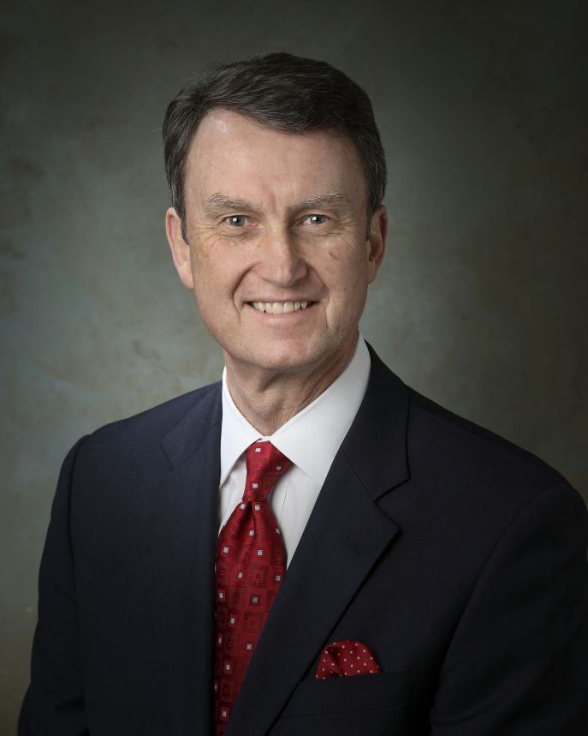
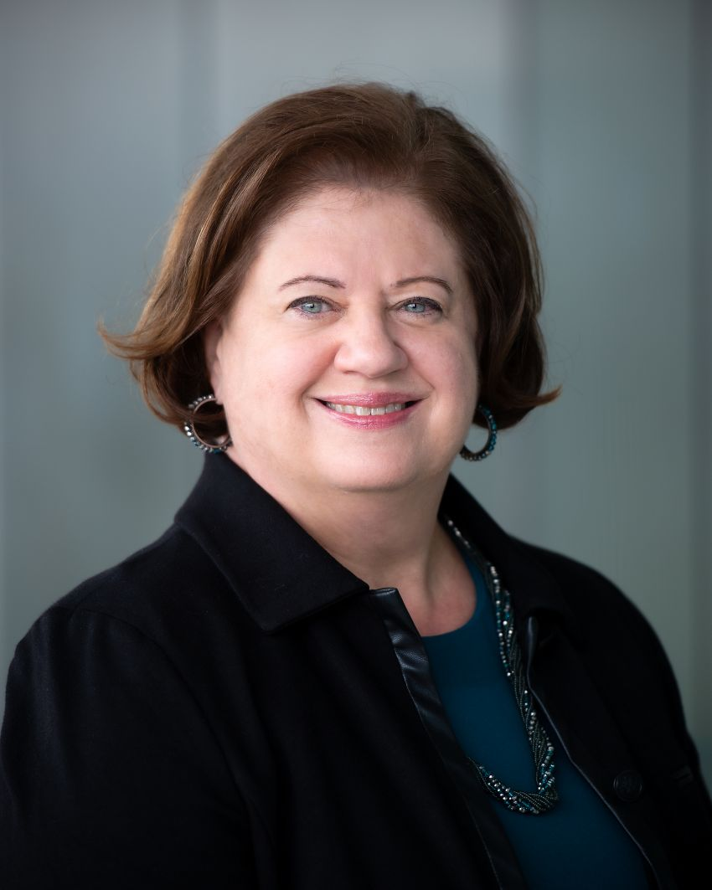
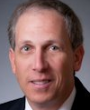
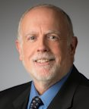
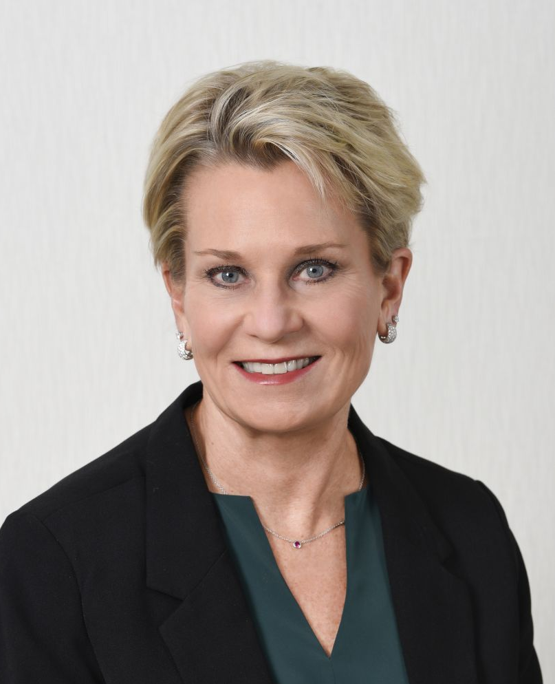
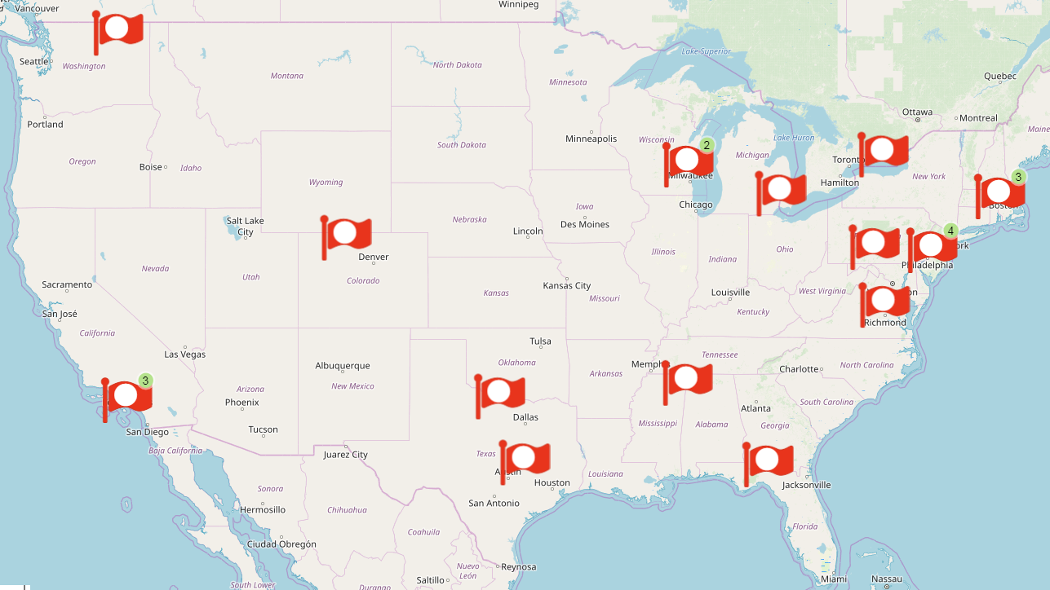
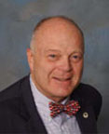
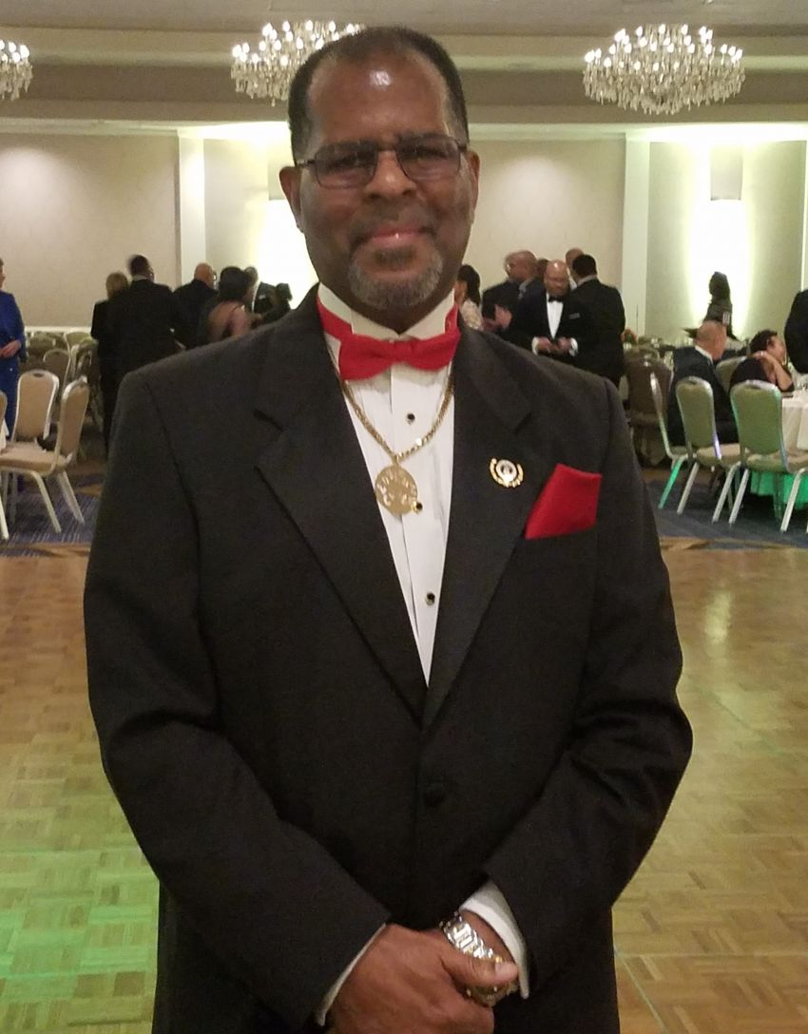
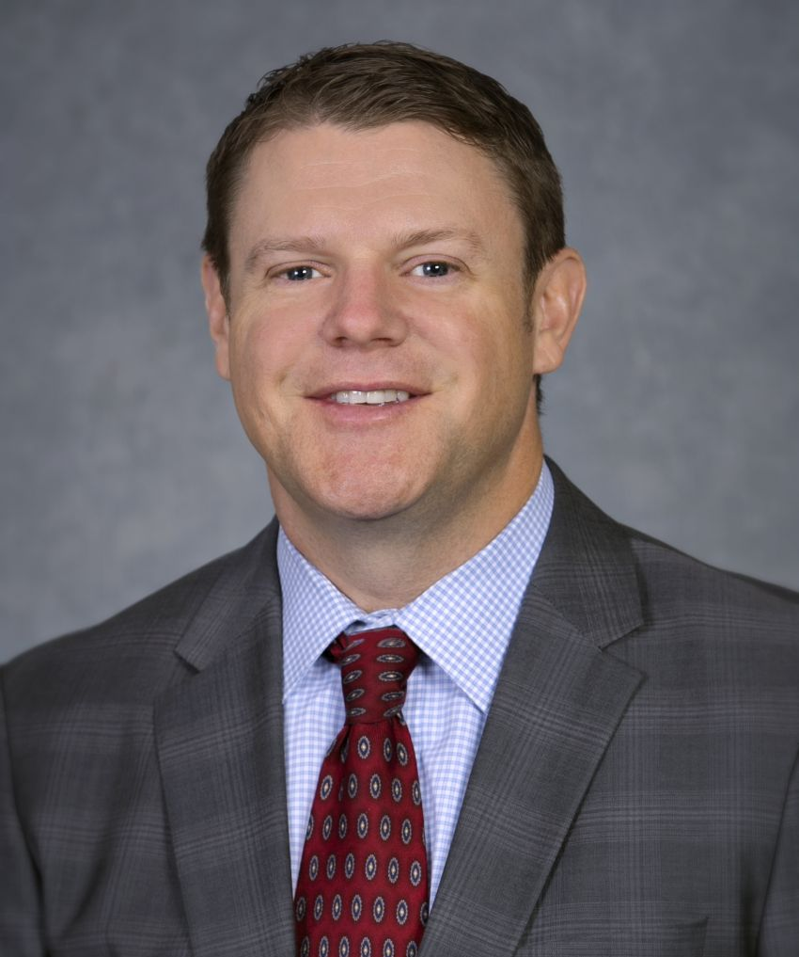
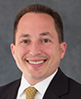
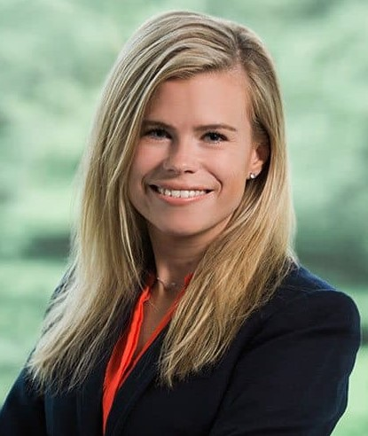
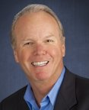
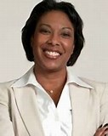
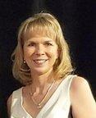
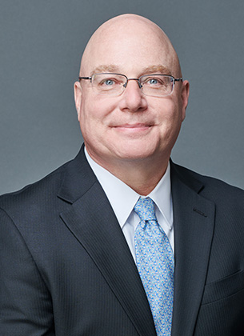
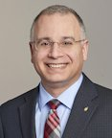
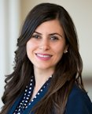
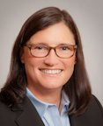
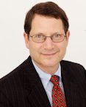
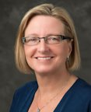
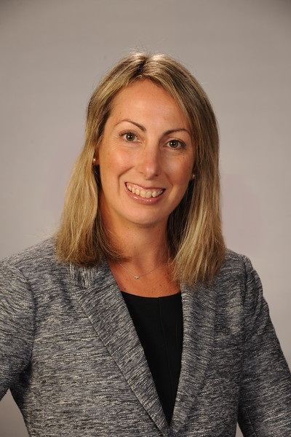
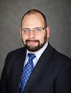
Our National Board of Directors
Board of Directors Executive Committee
Notes:
22 Officers & Directors Representing 16 States and 26 Affiliated Local Estate Planning Councils
Plus A Wealth of Non-board Volunteers from Across the Country

Slide 6
Our Structure
Nominating Committee
MEMBERSHIP
Board of Directors / Decision-Making Body
Estate Planning Hall of Fame Council
Executive
Committee
Past President’s Council
Collaboration Tower
Education Tower
Cultivation Tower
Accredited Estate Planner® Designation Committee
Annual Advanced Estate Planning Strategies Conference Committee
Council Relations Committee
Diversity, Equity & Inclusion Committee
Robert G. Alexander Webinar Series Committee
Council of Excellence
Committee
Web & Technology
Committee
Publications Committee (NAEPC Journal of Estate & Tax Planning)
Council Leader
Education Series Committee

Slide 7
Collaboration Tower
It is well-known that the client benefits when a group of
multi-disciplinary professionals collaborates on their estate planning needs.
This tower includes any committee, sub-committee or task force that emphasizes multi-disciplinary activities and programs.
Accredited Estate Planner® Designation Oversight Committee
Diversity, Equity & Inclusion Committee
Website & Technology
Committee
EXCELLENCE IN ESTATE PLANNING

Slide 8
Education Tower
Education helps estate planners stay current so they can offer the latest planning ideas to their clients.
This tower focuses on keeping every estate planning professional on the cutting-edge by providing access to, and education from, the profession’s leading experts in various formats.
Annual Advanced Estate Planning Strategies Conference Committee
Robert G. Alexander Webinar Series Committee
Publications Committee, the
Home of the
NAEPC Journal of
Estate & Tax Planning
EXCELLENCE IN ESTATE PLANNING

Slide 9
Cultivation Tower
Strong and lasting relationships lead to empowered and well-rounded members and enhanced member satisfaction.
This tower is the home to committees and activities that support the overall culture of the organization and emphasizes relationships between the various members of the association.
Council Relations Committee
Council of Excellence
Council Leader Education Series
EXCELLENCE IN ESTATE PLANNING

Slide 10
Snapshot of Council Benefits
Leadership Training & Best Practices
Council Leadership Day
Regional Leadership Day
Virtual Events
LinkedIn Group for Council Leaders
Website Solutions
Programming Resources
“No Charge” Program
Online Speaker Library
Information from Other Councils
Webinars
Steve Leimberg’s LISI Service
Council of Excellence Award
EXCELLENCE IN ESTATE PLANNING

Slide 11
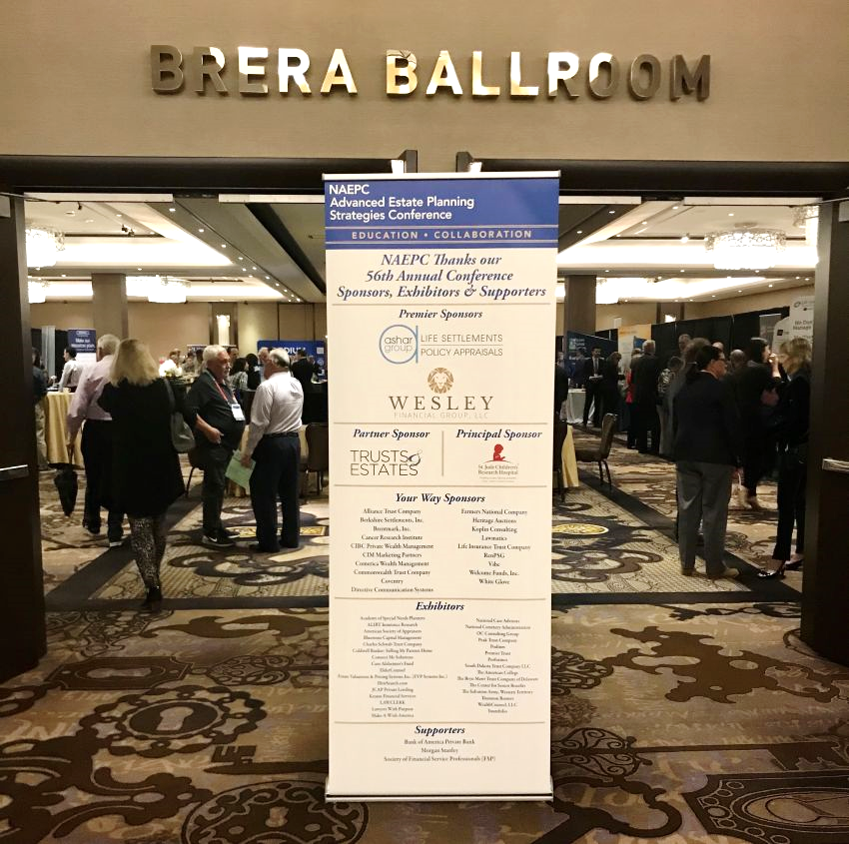
Snapshot of Member Benefits
Value Partners
Approximately 40 Member Benefit Providers
Reduced Cost for Programs Hosted in the Robert G. Alexander Webinar Series
Special Pricing to Attend the Annual Advanced Estate Planning Strategies Conference
EXCELLENCE IN ESTATE PLANNING

Slide 12
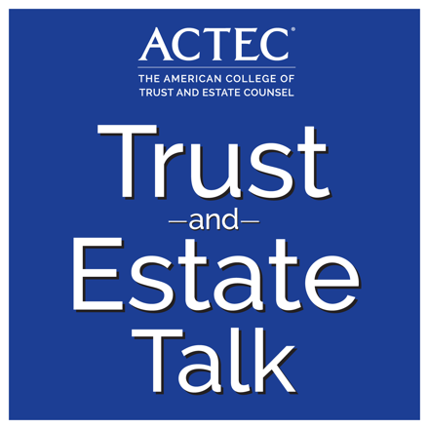
Sampling of Value Partners
EXCELLENCE IN ESTATE PLANNING
Notes:
ACTEC Trusts & Estate Talk – free podcasts
Klark Proposal Software – software to create professional looking client presentations
Ultimate Estate Planner – education and practical, tested and proven technical, practice-building and marketing products
FinancialAdvisors.com – marketing service
Arcadia Art Consultancy - full-service, tangible asset management firm that specializes in appraisal reporting, advisory, and collection management services for private collectors of fine art and other luxury assets
Heir Search – locate missing heirs
Lawgic – helps professionals create high-quality estate planning documents tailored to your clients’ individual needs
Lorman – education
Trusts & Estates – discounted magazine subscription
Estate Planning Binder.com – client-facing binders
Rocket Matter- cloud-based legal practice management solution
All-Language Alliance – legally-admissible document translation

Slide 13
60th Annual Advanced Estate Planning Strategies Conference with Pre-Conference Sessions for Estate Planning Council Leaders
November 13 – 16, 2023
Fort Lauderdale, Florida
3+ Days of Technical Education
Continuing Education Credit
Grow Your Network of Estate
Planning Professionals From
Around the Country
Discount for
Members of Affiliated Estate Planning Councils
Notes:
Registration is expected to open in late May – hotel registration will be open by the time you offer these presentations.

Slide 14
Accredited Estate Planner® Designation
Awarded by NAEPC to estate
planning professionals who
meet requirements of education,
experience, knowledge,
professional reputation,
and character.
EXCELLENCE IN ESTATE PLANNING
Notes:
These are the items that benefit the council itself – different from those that benefit the members directly.

Slide 15
Accredited Estate Planner® Designation
Why Become an AEP® Designee?
Recognition as a Professional Dedicated to the Team Concept
Demonstrate Special Knowledge & Abilities
National Referral Program
Private Designee-Only Events
EXCELLENCE IN ESTATE PLANNING
Notes:
These are the items that benefit the council itself – different from those that benefit the members directly.

Slide 16
Accredited Estate Planner® Designation
Requirements for All Applicants
Gateway Degree or Designation (see next slide)
Minimum Experience as a Practitioner
Presently & Significantly Engaged in Estate Planning
Member in Good Standing of an Estate Planning Council
Professional References or Council Nomination Resolution
EXCELLENCE IN ESTATE PLANNING
Notes:
These are the items that benefit the council itself – different from those that benefit the members directly.

Slide 17
Accredited Estate Planner® Designation
Credential Requirement - Active License or Certification as an:
Attorney
Accountant
Insurance & Financial Planning
Philanthropic Advisor
Trust Professional
Holding One or More of the Following Credentials:
JD, CPA, CLU®, CFP®, CFA, ChFC®, CPWA®, CAP®*, CSPG, CTFA, MSFS, or MST
* Special extra education requirement
EXCELLENCE IN ESTATE PLANNING
Notes:
These are the items that benefit the council itself – different from those that benefit the members directly.

Slide 18
Accredited Estate Planner® Designation
Two Pathways to Attainment through the Self-Nomination Program
Education
Successful Completion of 2 Graduate Courses through The
American College or Accredited Business or Law School for
those with a Minimum of Five Years of Experience
15-Year Experience Exemption to Coursework Requirement*
EXCELLENCE IN ESTATE PLANNING
Notes:
These are the items that benefit the council itself – different from those that benefit the members directly.

Slide 19
Accredited Estate Planner® Designation
Ongoing Commitments
NAEPC Code of Ethics
Yearly Continuing Education
Annual Recertification & Dues
Cooperation with Random Audit
EXCELLENCE IN ESTATE PLANNING
Notes:
These are the items that benefit the council itself – different from those that benefit the members directly.

Slide 20
Getting Involved
Learn More About NAEPC
Volunteer on Committees
Attend the Annual NAEPC Advanced Estate Planning Strategies Conference
Utilize Member Benefits
Subscribe and Read the NAEPC Journal of Estate & Tax Planning
Contact the National Office
Eleanor M. Spuhler 866-226-2224
eleanor@naepc.org
Hold the control button down when clicking if links do not open with a single click.
EXCELLENCE IN ESTATE PLANNING
Notes:
You may have to hold down the control tab when clicking to activate the link.

